Slide 1
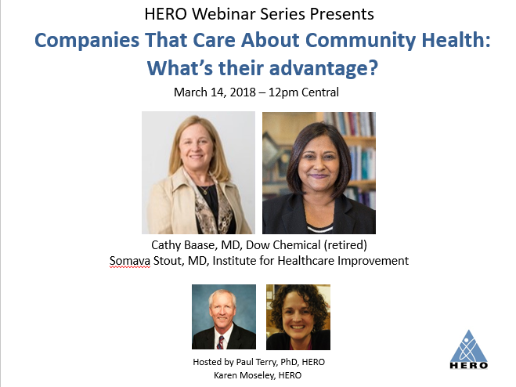

Slide 2
Imagining then Exploring: Business Involvement

Slide 3
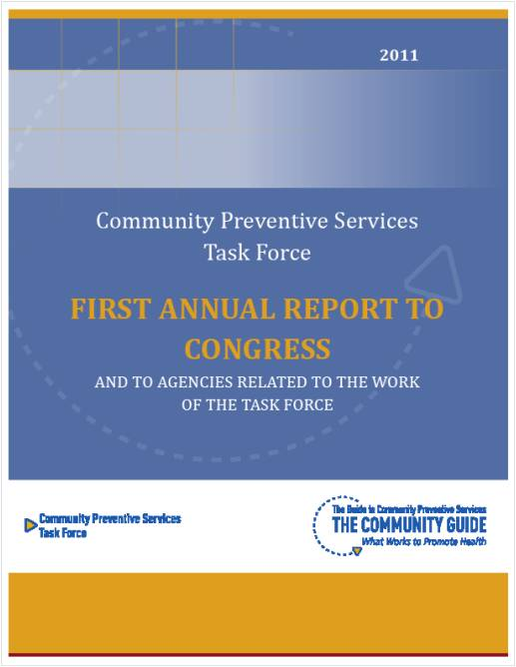
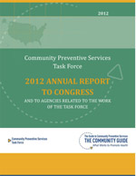
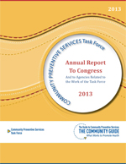
Community Preventive Services Task Force: Why Community Health Improvement Is Important
Reduce healthcare spending
Lower need and demand for health care
Reduce illness burden
Fewer cases, improved function
Make healthy choices easy choices
Environmental and policy changes
Maintain or improve economic vitality
Healthy communities complement vibrant business and industry
Increase healthy longevity
Today’s youth may live shorter and less healthy lives than their parents
Prepare the future workforce
A healthy workforce through education and skill building
Notes:
From a public and population health sciences perspective, the Community Preventive Services Task Force has identified several reasons why community health improvement has benefits to multiple stakeholders, including the business and industry sector.

Slide 4
What and How - Business Engagement in Community Health and Well-being
Connectivity with corporate priorities
Sustainability, Attract and Retain Talent, Profitability, Safety, etc.
Existing Actions – More Intentional & Informed
Philanthropy
Leadership roles in communities – informed and insightful action
Community Advisory Panels
Advocacy; Federal and State
Volunteerism
New Actions - Extensions of Strategy
Support and participation in multi-stakeholder community work
Direct action of your technology, services and/ or products
Integrate health into corporate reporting

Slide 5
Brief history of the HWHC initiative
Environmental scan
Executive convening
Business case development
Site Visits/ Case Study
Dissemination and linking to other efforts

Slide 6
Environmental scan The Why
Improve health of family members to further reduce health care costs
Influence other levers and drivers of health care costs beyond the workplace setting
Enhance corporate reputation
Healthy vibrant communities that draw new talent and retain current staff

Slide 7
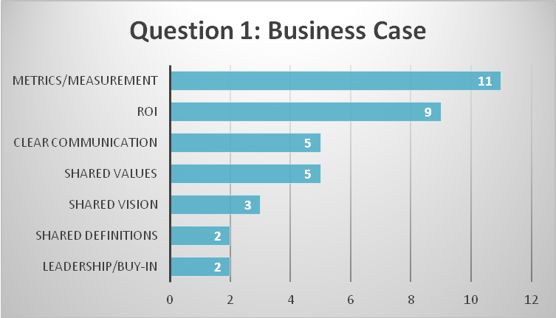
HERO World Café results

Slide 8
HERO World Café results

Slide 9
GetHWHC.org

Slide 10
Moving forward
Business Case Development and Evolution
Compliance-Driven
Charitable
Strategic
Systemic
e.g. meeting minimal regulatory standards for worker safety
e.g. corporate giving campaigns that enhance company brand, image
e.g. core business and management systems deployed to generate health and business value
e.g. systemic solutions designed to intentionally generate population health, business value, and address social determinants of health
Adapted from: Visser W. J Bus Systems, 2010; A New CSR Frontier. BSR, 2013; HERO: Role of Corporate America in Community Health, 2014
Notes:
Based on various reports and observations, I have placed the need for a business case development in population health for B&I in context of a continuum across which companies may find themselves. Early on, the main driver for engagement in population health may be entirely driven by regulatory considerations, such as OSHA related to worker safety. The next level refers to charitable giving providing opportunity for companies to be visible in doing good. Moving from there to be more strategic, companies may set up systems to connect health and safety to business value and eventually this becomes a systemic approach akin to a culture of health and well-being at the workplace that connects to the community and reflects a norm and value system that appreciates the need to address macro-social determinants of population health.
Benefits that may drive an intentional investment that represents “doing well by doing good”—those that drive value and are linked to business performance:
Enhanced corporate image-visibility, stewardship, social responsibility
Being an employer of choice
Enhanced employee morale, job satisfaction, job fulfillment, and teamwork
Engaged employees and increased productivity
Increased creativity and innovation
Improved attraction and retention of top talent
Reduced sickness absence
Reduced absenteeism, presenteeism, and turnover and improved productivity
Reduced workplace injury
Reduced benefits costs (health care costs, SLT, LTD, WC claims)
Better management of an aging workforce
Increased awareness and knowledge of self management of health
Reduced workplace stress
Reduced injuries
Increased energy, resilience, vitality
Improved concentration, focus and time-on-task
Improved team relationships and social cohesion
Enhanced well-being and happiness
Increased employee engagement

Slide 11
Poll Question 1
Which of the following factors do you believe had the greatest impact on preventable sickness and early death?
A risk factor like smoking or obesity
Social isolation
A and B have similar impact

Slide 12
Poll Question 2
Which of the following are most heavily weighted via points in “Best Practices Scorecards” in workplace wellness?
A risk factor like smoking or obesity
Social isolation
A and B are weighted similarly in scorecards

Slide 13
Making meaningful measurement easier
Somava Stout, MD, MS: Vice President, Institute for Healthcare Improvement, and Executive Lead for 100 Million Healthier Lives
Sharing Knowledge to Build a Culture of Health
May 9, 2016

Slide 14
100 Million Healthier Lives Measurement Resources (www.100mlives.org/measure)
Overall conceptual framework
Simple, powerful, usable tool to understand the wellbeing of people and places across a wide range of contexts
Searchable menu of measures to support change makers to find measures that fit the change they are making
A platform to help you see and track data over time and easily share data across partners in a community

Slide 15
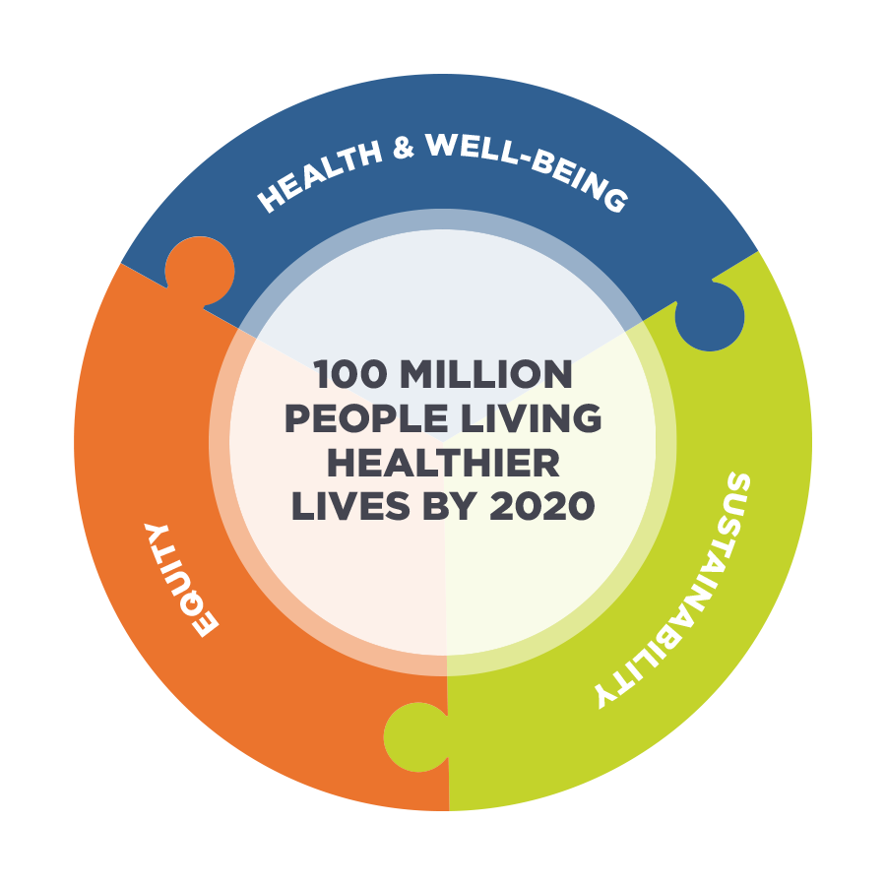
100 Million Healthier Lives Measurement Approach
Whose Lives Are Getting Better Because We Are Here?
Would they
agree?
If not, what will
we do differently?
Who isn’t
thriving?

Slide 16
Counting Healthier Lives
COMMUNITY-SPECIFIC METRICS
Well-being x
Length of Life =
Wellbeing adjust life years (WALYs)
Indicators related to your improvement initiatives

Slide 17
A simple, powerful approach: People reported outcome measures (PROM)
People reported outcome measures are validated, objective measures of people’s perception of their health and wellbeing
People’s self-perception of their health and wellbeing is as or more accurate than anything else we have to predict long-term morbidity and mortality.
When combined with predicted life expectancy, the two serve as powerful and objective drivers to improve health, wellbeing and equity.

Slide 18
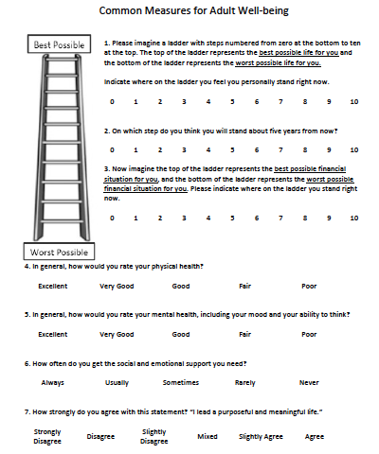
% people thriving
% people suffering
% people with hope
Age
Sex
Race/Ethnicity
Education
Zip code
Veteran status
We will do a webinar and offer coaching to help you set up your measurement system for wellbeing measures.
Notes:
The first 3 questions ask people to imagine a ladder, imagining…
This question predicts % of people thriving overall and what % people suffering.
Q2: Calculates % of people with hope (relevant to initial equity driver diagram where hope is an outcome)
Q3: Putting your financial situation on the ladder is most predictive of equity gaps, based on KP data.
--And there are 6 additional equity lenses we use
These 3 questions give an incredibly powerful tool to improve overall wellbeing and equity.
What we don’t know are the details underneath it.

Slide 19
Overall well-being
Common Measures for Adult Well-being
Social
Physical
4 subdomains:
Mental,
physical,
social, spiritual
Mental
Social
Spiritual
Notes:
So we have the additional 4 domains to help understand that.
Waterville team added some additional questions relative to social wellbeing.
They knew that 1 in 5 people in Maine were food insecure. When they did the survey over 40% felt that no one cared about them.
Realized that while they had a problem w/ food insecurity, they had an epidemic of social isolation.
SI is very strongly correlated, even more strongly than tobacco, re: its impact on health and live
Measuring equity is breaking it down between the equity questions and the financial security questions.

Slide 20
6 common lenses to understand who isn’t thriving:
Age
Sex
Race/Ethnicity
Education
Zip code
Veteran status
We will do a webinar and offer coaching to help you set up your measurement system for wellbeing measures.
Notes:
This bring it all together in terms of overall wellbeing + equity
Adolescent wellbeing assessment coming soons

Slide 21
Downtown Women’s Center Results
Figure 1. % of people suffering
84% improvement
in healthier lives
92% improved
blood pressure
44% improved A1C
Figure 2. % of people thriving

Slide 22
Health and Social Inequity are Interconnected and Related to Place
2 newborns will have a 25 year gap in life expectancy 2 miles apart
based on where they grow up

Slide 23
Measures of health and wellbeing at multiple levels
Employee/
family
Systems of society
Community
Health, wellbeing and equity
Notes:
Can we create measures of physical, mental, social and spiritual wellbeing at the level of the community and society?

Slide 24
Menu of Measures at All Levels
Employee/Family | Community (NCVHS) | Society
Length of life | Physical health: Access to healthy foods, walkability | Federal funding for pedestrian and bike programs
Well-being | Mental health: Perceived safety | Inequality in educational attainment
WALYs | Social wellbeing: High school graduation rate, unemployment rate | Percent growth in healthcare spending
Differences in health & well-being | Social wellbeing: social connectedness | Corporate contributions to education and community development
Years of potential life gained | Spiritual wellbeing: civic pride, hope, resilience | Political rights
Notes:
Communities are working on very different scales (e.g., county change vs. specific ethnic group) – and need measures at different levels, including individual/pop, community, society.
Define each level and provide examples

Slide 25
Metrics that Matter Wizard

Slide 26
Measure the change that you wish to see in the world. - Gandhi (modified)

Slide 27
Poll Question 3
What most closely reflects your organization’s wellness related focus?
Employee
Employee and family
Employee, family, and community
We’re moving from A and B toward C
We’re likely to stay focused on A and/or B

Slide 28
Poll Question 4
Some say we have moved from “Wellness to Well-being”. What was missing most in “wellness”?
Mental / emotional well-being
Financial well-being
Community well-being
A, B, C were equally missing
I don’t think there is much difference between wellness and well-being

Slide 29
Poll Question 5
What most closely reflects your organization’s approach to volunteerism?
We don’t have a policy and it’s not a part of our communications with employees
It’s encouraged and recognized but occurs on employee time
We have a volunteerism policy that specifies paid time off
We have a volunteerism policy that specifies paid time off and it’s integrated with wellness offerings

Slide 30
Poll Question 6
What is your view on a good company volunteerism policy?
It’s a private matter and not the company’s business
Should be encouraged but not on company time
I favor policies that offer some company time
I favor a policy of 40 hours paid time per year

Slide 31
Poll Question 7
You can’t manage what you can’t measure. Which of these most closely reflects your measurement approach?
Biometric screening data only
Mental and physical health (i.e. via HRA and Biometrics combined)
Mental, physical, and organizational culture
A, B, C and our community impact / footprint
A, B, C and D with integrated analysis

Slide 32
Poll Question 8
What most closely reflects the connection between your health promotion work and your corporate social responsibility work?
Fully integrated planning, data collection, and reporting
Coordinated but not integrated
Ad hoc, occasional collaboration
There is no connection between our wellness and CSR

